Slide 1
02 Applications (Chapter 9)
Copyright © 2010, Elsevier Inc. All rights Reserved
Notes:
The University of Adelaide, School of Computer Science
Chapter 2 — Instructions: Language of the Computer

Slide 2
Problem
Applications need their own protocols in addition to traditional application program part
This chapter explores some of the most popular network applications available today.
Notes:
The University of Adelaide, School of Computer Science
Chapter 2 — Instructions: Language of the Computer

Slide 3
Chapter Outline
Traditional Network Applications
Infrastructure Services
Overlay Networks
Notes:
The University of Adelaide, School of Computer Science
Chapter 2 — Instructions: Language of the Computer

Slide 4
Traditional Applications
Two of the most popular—
  The World Wide Web and
  Email.
Broadly speaking, both of these applications use the request/reply paradigm—users send requests to servers, which then respond accordingly.
Notes:
The University of Adelaide, School of Computer Science
Chapter 2 — Instructions: Language of the Computer

Slide 5
Traditional Applications
application vs. application programs implementation vs. application protocols
  Eg. Web vs. web browsers/servers vs. HyperText Transport Protocol (HTTP)
Notes:
The University of Adelaide, School of Computer Science
Chapter 2 — Instructions: Language of the Computer

Slide 6
Traditional Applications
Two very widely-used, standardized application protocols:
  SMTP: Simple Mail Transfer Protocol is used to exchange electronic mail.
  HTTP: HyperText Transport Protocol is used to communicate between Web browsers and Web servers.
Notes:
The University of Adelaide, School of Computer Science
Chapter 2 — Instructions: Language of the Computer

Slide 7

Electronic mail
outgoing
message queue
Three major components:
user agents
mail servers
simple mail transfer protocol: SMTP
User Agent
a.k.a. “mail reader”
composing, editing, reading mail messages
e.g., Outlook, Thunderbird, iPhone mail client
outgoing, incoming messages stored on server
user
agent
user mailbox
mail
server
user
agent
SMTP
mail
server
user
agent
SMTP
SMTP
user
agent
mail
server
user
agent
user
agent

Slide 8
Electronic mail: mail servers
mail servers:
mailbox contains incoming messages for user
message queue of outgoing (to be sent) mail messages
SMTP protocol between mail servers to send email messages
  client: sending mail server
  “server”: receiving mail server
user
agent
mail
server
user
agent
SMTP
mail
server
user
agent
SMTP
SMTP
user
agent
mail
server
user
agent
user
agent

Slide 9
Electronic Mail: SMTP [RFC 2821]
uses TCP to reliably transfer email message from client to server, port 25
direct transfer: sending server to receiving server
three phases of transfer
  handshaking (greeting)
  transfer of messages
  closure
command/response interaction (like HTTP, FTP)
  commands: ASCII text
  response: status code and phrase
messages must be in 7-bit ASCI

Slide 10


Scenario: Alice sends message to Bob
1) Alice uses UA to compose message “to” bob@someschool.edu
2) Alice’s UA sends message to her mail server; message placed in message queue
3) client side of SMTP opens TCP connection with Bob’s mail server
4) SMTP client sends Alice’s message over the TCP connection
5) Bob’s mail server places the message in Bob’s mailbox
6) Bob invokes his user agent to read message
user
agent
mail
server
user
agent
1
mail
server
2
3
6
4
Alice’s mail server
5
Bob’s mail server

Slide 11
Sample SMTP interaction
S: 220 hamburger.edu
C: HELO crepes.fr
S: 250 Hello crepes.fr, pleased to meet you
C: MAIL FROM: <alice@crepes.fr>
S: 250 alice@crepes.fr... Sender ok
C: RCPT TO: <bob@hamburger.edu>
S: 250 bob@hamburger.edu ... Recipient ok
C: DATA
S: 354 Enter mail, end with "." on a line by itself
C: Do you like ketchup?
C: How about pickles?
C: .
S: 250 Message accepted for delivery
C: QUIT
S: 221 hamburger.edu closing connection

Slide 12
Try SMTP interaction for yourself:
telnet servername 25
see 220 reply from server
enter HELO, MAIL FROM, RCPT TO, DATA, QUIT commands
above lets you send email without using email client (reader)

Slide 13
SMTP: final words
SMTP uses persistent connections
SMTP requires message (header & body) to be in 7-bit ASCII
SMTP server uses CRLF.CRLF to determine end of message
comparison with HTTP:
HTTP: pull
SMTP: push
both have ASCII command/response interaction, status codes
HTTP: each object encapsulated in its own response msg
SMTP: multiple objects sent in multipart msg

Slide 14
Mail message format
SMTP: protocol for exchanging email msgs
RFC 822: standard for text message format:
header lines, e.g.,
  To:
  From:
  Subject:
  different from SMTP MAIL FROM, RCPT TO: commands!
Body: the “message”
  ASCII characters only
header
blank
line
body

Slide 15
Mail access protocols
user
agent
mail access
protocol
user
agent
SMTP
SMTP
(e.g., POP,
IMAP)
sender’s mail
server
receiver’s mail
server
SMTP: delivery/storage to receiver’s server
mail access protocol: retrieval from server
  POP: Post Office Protocol [RFC 1939]: authorization, download
  IMAP: Internet Mail Access Protocol [RFC 1730]: more features, including manipulation of stored msgs on server
  HTTP: gmail, Hotmail, Yahoo! Mail, etc.

Slide 16
POP3 protocol
S: +OK POP3 server ready
C: user bob
S: +OK
C: pass hungry
S: +OK user successfully logged on
authorization phase
client commands:
  user: declare username
  pass: password
server responses
  +OK
  -ERR
transaction phase, client:
list: list message numbers
retr: retrieve message by number
dele: delete
quit
C: list
S: 1 498
S: 2 912
S: .
C: retr 1
S: <message 1 contents>
S: .
C: dele 1
C: retr 2
S: <message 1 contents>
S: .
C: dele 2
C: quit
S: +OK POP3 server signing off

Slide 17
POP3 (more) and IMAP
more about POP3
previous example uses POP3 “download and delete” mode
  Bob cannot re-read e-mail if he changes client
POP3 “download-and-keep”: copies of messages on different clients
POP3 is stateless across sessions
IMAP
keeps all messages in one place: at server
allows user to organize messages in folders
keeps user state across sessions:
  names of folders and mappings between message IDs and folder name

Slide 18
Traditional Applications
World Wide Web
  So successful and sometimes it seems to be synonymous with the Internet.
  In fact, the design of the system that became the Web started around 1989, long after the Internet had become a widely deployed system.
  The original goal of the Web was to find a way to organize and retrieve information, drawing on ideas about hypertext—interlinked documents—that had been around since at least the 1960s.
Notes:
The University of Adelaide, School of Computer Science
Chapter 2 — Instructions: Language of the Computer

Slide 19
Web and HTTP
First, a review…
web page consists of objects
object can be HTML file, JPEG image, Java applet, audio file,…
web page consists of base HTML-file which includes several referenced objects
each object is addressable by a URL, e.g.,
www.someschool.edu/someDept/pic.gif
host name
path name

Slide 20

HTTP overview
HTTP: hypertext transfer protocol
Web’s application layer protocol
client/server model
  client: browser that requests, receives, (using HTTP protocol) and “displays” Web objects
  server: Web server sends (using HTTP protocol) objects in response to requests
HTTP request
PC running
Firefox browser
HTTP response
HTTP request
server
running
Apache Web
server
HTTP response
iphone running
Safari browser

Slide 21
HTTP overview (continued)
uses TCP:
client initiates TCP connection (creates socket) to server, port 80
server accepts TCP connection from client
HTTP messages (application-layer protocol messages) exchanged between browser (HTTP client) and Web server (HTTP server)
TCP connection closed
HTTP is “stateless”
server maintains no information about past client requests
aside
protocols that maintain “state” are complex!
past history (state) must be maintained
if server/client crashes, their views of “state” may be inconsistent, must be reconciled

Slide 22
HTTP connections
non-persistent HTTP
at most one object sent over TCP connection
  connection then closed
downloading multiple objects required multiple connections
persistent HTTP
multiple objects can be sent over single TCP connection between client, server

Slide 23
Non-persistent HTTP
suppose user enters URL:
(contains text,
references to 10
jpeg images)
www.someSchool.edu/someDepartment/home.index
1a. HTTP client initiates TCP connection to HTTP server (process) at www.someSchool.edu on port 80
1b. HTTP server at host www.someSchool.edu waiting for TCP connection at port 80. “accepts” connection, notifying client
2. HTTP client sends HTTP request message (containing URL) into TCP connection socket. Message indicates that client wants object someDepartment/home.index
3. HTTP server receives request message, forms response message containing requested object, and sends message into its socket
time

Slide 24
Non-persistent HTTP (cont.)
4. HTTP server closes TCP connection.
5. HTTP client receives response message containing html file, displays html. Parsing html file, finds 10 referenced jpeg objects
time
6. Steps 1-5 repeated for each of 10 jpeg objects

Slide 25
Non-persistent HTTP: response time
RTT (definition): time for a small packet to travel from client to server and back
HTTP response time:
one RTT to initiate TCP connection
one RTT for HTTP request and first few bytes of HTTP response to return
file transmission time
non-persistent HTTP response time = 2RTT+ file transmission time
initiate TCP
connection
RTT
request
file
RTT
time to
transmit
file
file
received
time
time

Slide 26
Persistent HTTP
non-persistent HTTP issues:
requires 2 RTTs per object
OS overhead for each TCP connection
browsers often open parallel TCP connections to fetch referenced objects
persistent HTTP:
server leaves connection open after sending response
subsequent HTTP messages between same client/server sent over open connection
client sends requests as soon as it encounters a referenced object
as little as one RTT for all the referenced objects

Slide 27
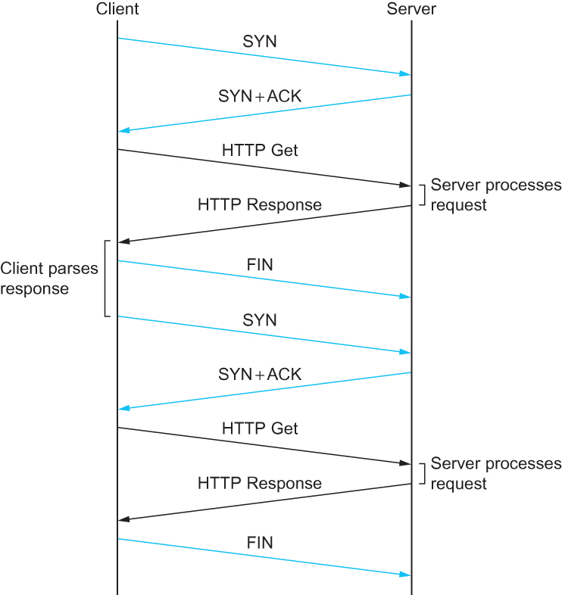
HTTP – TCP Connections
HTTP 1.0 behavior
Notes:
The University of Adelaide, School of Computer Science
Chapter 2 — Instructions: Language of the Computer

Slide 28
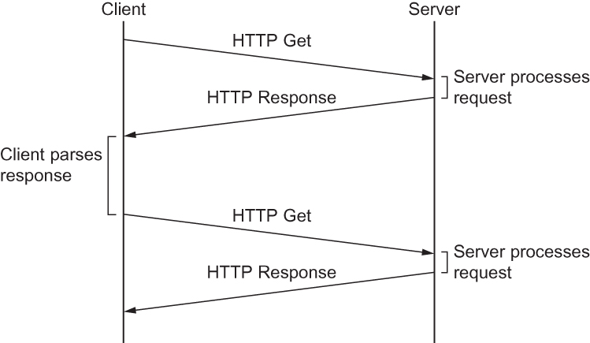
HTTP – TCP Connections
HTTP 1.1 behavior with persistent connections
Notes:
The University of Adelaide, School of Computer Science
Chapter 2 — Instructions: Language of the Computer

Slide 29
HTTP request message
two types of HTTP messages: request, response
HTTP request message:
  ASCII (human-readable format)
carriage return character
request line
(GET, POST,
HEAD commands)
line-feed character
GET /index.html HTTP/1.1\r\n
Host: www-net.cs.umass.edu\r\n
User-Agent: Firefox/3.6.10\r\n
Accept: text/html,application/xhtml+xml\r\n
Accept-Language: en-us,en;q=0.5\r\n
Accept-Encoding: gzip,deflate\r\n
Accept-Charset: ISO-8859-1,utf-8;q=0.7\r\n
Keep-Alive: 115\r\n
Connection: keep-alive\r\n
\r\n
header
lines
carriage return,
line feed at start
of line indicates
end of header lines

Slide 30
HTTP request message: general format
method
sp
URL
sp
version
cr
request
line
lf
header field name
value
cr
lf
~
~
header
lines
~
~
header field name
value
cr
lf
cr
lf
~
entity body
~
body
~
~

Slide 31
Uploading form input
POST method:
web page often includes form input
input is uploaded to server in entity body
URL method:
uses GET method
input is uploaded in URL field of request line:
www.somesite.com/animalsearch?monkeys&banana

Slide 32
Method types
HTTP/1.0:
GET
POST
HEAD
  asks server to leave requested object out of response
HTTP/1.1:
GET, POST, HEAD
PUT
  uploads file in entity body to path specified in URL field
DELETE
  deletes file specified in the URL field

Slide 33
HTTP response message
status line
(protocol
status code
status phrase)
HTTP/1.1 200 OK\r\n
Date: Sun, 26 Sep 2010 20:09:20 GMT\r\n
Server: Apache/2.0.52 (CentOS)\r\n
Last-Modified: Tue, 30 Oct 2007 17:00:02 GMT\r\n
ETag: "17dc6-a5c-bf716880"\r\n
Accept-Ranges: bytes\r\n
Content-Length: 2652\r\n
Keep-Alive: timeout=10, max=100\r\n
Connection: Keep-Alive\r\n
Content-Type: text/html; charset=ISO-8859-1\r\n
\r\n
data data data data data ...
header
lines
data, e.g.,
requested
HTML file

Slide 34
HTTP response status codes
status code appears in 1st line in server-to-client response message.
some sample codes:
200 OK
  request succeeded, requested object later in this msg
301 Moved Permanently
  requested object moved, new location specified later in this msg (Location:)
400 Bad Request
  request msg not understood by server
404 Not Found
  requested document not found on this server
505 HTTP Version Not Supported

Slide 35
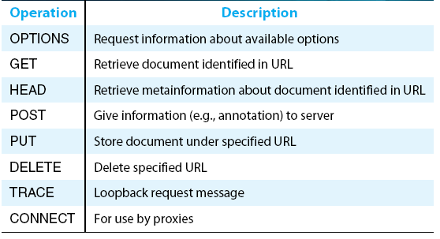
HTTP Request Messages
HTTP request operations
Notes:
The University of Adelaide, School of Computer Science
Chapter 2 — Instructions: Language of the Computer

Slide 36
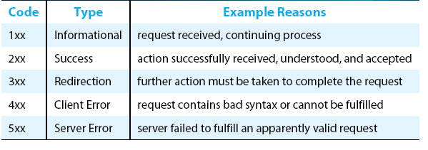
HTTP Response Messages
Five types of HTTP result codes
Notes:
The University of Adelaide, School of Computer Science
Chapter 2 — Instructions: Language of the Computer

Slide 37
Trying out HTTP (client side) for yourself
1. Telnet to your favorite Web server:
telnet cis.poly.edu 80
opens TCP connection to port 80
(default HTTP server port) at cis.poly.edu.
anything typed in sent
to port 80 at cis.poly.edu
2. type in a GET HTTP request:
GET /~ross/ HTTP/1.1
Host: cis.poly.edu
by typing this in (hit carriage
return twice), you send
this minimal (but complete)
GET request to HTTP server
3. look at response message sent by HTTP server!
(or use Wireshark to look at captured HTTP request/response)

Slide 38
User-server state: cookies
example:
Susan always access Internet from PC
visits specific e-commerce site for first time
when initial HTTP requests arrives at site, site creates:
  unique ID
  entry in backend database for ID
many Web sites use cookies
four components:
  1) cookie header line of HTTP response message
  2) cookie header line in next HTTP request message
  3) cookie file kept on user’s host, managed by user’s browser
  4) back-end database at Web site

Slide 39
Cookies: keeping “state” (cont.)
client
server
ebay 8734
usual http request msg
Amazon server
creates ID
1678 for user
cookie file
usual http response
set-cookie: 1678
backend
database
create
entry
ebay 8734
amazon 1678
usual http request msg
cookie: 1678
cookie-
specific
action
access
usual http response msg
one week later:
access
ebay 8734
amazon 1678
usual http request msg
cookie: 1678
cookie-
specific
action
usual http response msg

Slide 40
Cookies (continued)
aside
what cookies can be used for:
authorization
shopping carts
recommendations
user session state (Web e-mail)
cookies and privacy:
cookies permit sites to learn a lot about you
you may supply name and e-mail to sites
how to keep “state”:
protocol endpoints: maintain state at sender/receiver over multiple transactions
cookies: http messages carry state

Slide 41

Web caches (proxy server)
goal: satisfy client request without involving origin server
user sets browser: Web accesses via cache
browser sends all HTTP requests to cache
  object in cache: cache returns object
  else cache requests object from origin server, then returns object to client
proxy
server
HTTP request
HTTP request
client
origin
server
HTTP response
HTTP response
HTTP request
HTTP response
client
origin
server

Slide 42
More about Web caching
cache acts as both client and server
  server for original requesting client
  client to origin server
typically cache is installed by ISP (university, company, residential ISP)
why Web caching?
reduce response time for client request
reduce traffic on an institution’s access link
Internet dense with caches: enables “poor” content providers to effectively deliver content (so too does P2P file sharing)

Slide 43

Caching example:
assumptions:
avg object size: 100K bits
avg request rate from browsers to origin servers:15/sec
avg data rate to browsers: 1.50 Mbps
RTT from institutional router to any origin server: 2 sec
access link rate: 1.54 Mbps
consequences:
LAN utilization: 15%
access link utilization = 99%
total delay = Internet delay + access delay + LAN delay
= 2 sec + minutes + usecs
origin
servers
public
Internet
1.54 Mbps
access link
institutional
network
problem!
1 Gbps LAN

Slide 44
Caching example: fatter access link
assumptions:
avg object size: 100K bits
avg request rate from browsers to origin servers:15/sec
avg data rate to browsers: 1.50 Mbps
RTT from institutional router to any origin server: 2 sec
access link rate: 1.54 Mbps
consequences:
LAN utilization: 15%
access link utilization = 99%
total delay = Internet delay + access delay + LAN delay
= 2 sec + minutes + usecs
origin
servers
public
Internet
1.54 Mbps
access link
154 Mbps
154 Mbps
institutional
network
9.9%
1 Gbps LAN
msecs
Cost: increased access link speed (not cheap!)

Slide 45
Caching example: install local cache
assumptions:
avg object size: 100K bits
avg request rate from browsers to origin servers:15/sec
avg data rate to browsers: 1.50 Mbps
RTT from institutional router to any origin server: 2 sec
access link rate: 1.54 Mbps
consequences:
LAN utilization: 15%
access link utilization =
total delay =
origin
servers
public
Internet
1.54 Mbps
access link
?
?
institutional
network
1 Gbps LAN
How to compute link
utilization, delay?
local web
cache
Cost: web cache (cheap!)

Slide 46
Caching example: install local cache
Calculating access link utilization, delay with cache:
suppose cache hit rate is 0.4
  40% requests satisfied at cache, 60% requests satisfied at origin
origin
servers
public
Internet
access link utilization:
  60% of requests use access link
data rate to browsers over access link = 0.6*1.50 Mbps = .9 Mbps
  utilization = 0.9/1.54 = .58
1.54 Mbps
access link
total delay
  = 0.6 * (delay from origin servers) +0.4 * (delay when satisfied at cache)
  = 0.6 (2.01) + 0.4 (~msecs)
  = ~ 1.2 secs
  less than with 154 Mbps link (and cheaper too!)
institutional
network
1 Gbps LAN
local web
cache

Slide 47
Conditional GET
Goal: don’t send object if cache has up-to-date cached version
  no object transmission delay
  lower link utilization
cache: specify date of cached copy in HTTP request
  If-modified-since: <date>
server: response contains no object if cached copy is up-to-date:
  HTTP/1.0 304 Not Modified
client
server
HTTP request msg
If-modified-since: <date>
object
not
modified
before
<date>
HTTP response
HTTP/1.0
304 Not Modified
HTTP request msg
If-modified-since: <date>
object
modified
after
<date>
HTTP response
HTTP/1.0 200 OK
<data>

Slide 48
Chapter Outline
Traditional Applications
Infrastructure Services
Overlay Networks
Notes:
The University of Adelaide, School of Computer Science
Chapter 2 — Instructions: Language of the Computer

Slide 49
DNS: domain name system
people: many identifiers:
  SSN, name, passport #
Internet hosts, routers:
  IP address (32 bit) - used for addressing datagrams
  “name”, e.g., www.yahoo.com - used by humans
Q: how to map between IP address and name, and vice versa ?
Domain Name System:
distributed database implemented in hierarchy of many name servers
application-layer protocol: hosts, name servers communicate to resolve names (address/name translation)
  note: core Internet function, implemented as application-layer protocol
  complexity at network’s “edge”

Slide 50
DNS: services, structure
DNS services
hostname to IP address translation
host aliasing
  canonical, alias names
mail server aliasing
load distribution
  replicated Web servers: many IP addresses correspond to one name
why not centralize DNS?
single point of failure
traffic volume
distant centralized database
maintenance
A: doesn’t scale!

Slide 51
DNS: a distributed, hierarchical database
Root DNS Servers
…
…
com DNS servers
org DNS servers
edu DNS servers
yahoo.com
DNS servers
pbs.org
DNS servers
poly.edu
DNS servers
umass.edu
DNS servers
amazon.com
DNS servers
client wants IP for www.amazon.com; 1st approx:
client queries root server to find com DNS server
client queries .com DNS server to get amazon.com DNS server
client queries amazon.com DNS server to get IP address for www.amazon.com

Slide 52

DNS: root name servers
contacted by local name server that can not resolve name
root name server:
  contacts authoritative name server if name mapping not known
  gets mapping
  returns mapping to local name server
c. Cogent, Herndon, VA (5 other sites)
d. U Maryland College Park, MD
h. ARL Aberdeen, MD
j. Verisign, Dulles VA (69 other sites )
k. RIPE London (17 other sites)
i. Netnod, Stockholm (37 other sites)
e. NASA Mt View, CA
f. Internet Software C.
Palo Alto, CA (and 48 other sites)
m. WIDE Tokyo
(5 other sites)
13 root name “servers” worldwide
a. Verisign, Los Angeles CA
(5 other sites)
b. USC-ISI Marina del Rey, CA
l. ICANN Los Angeles, CA
(41 other sites)
g. US DoD Columbus, OH (5 other sites)

Slide 53
TLD, authoritative servers
top-level domain (TLD) servers:
  responsible for com, org, net, edu, aero, jobs, museums, and all top-level country domains, e.g.: uk, fr, ca, jp
  Network Solutions maintains servers for .com TLD
  Educause for .edu TLD
authoritative DNS servers:
  organization’s own DNS server(s), providing authoritative hostname to IP mappings for organization’s named hosts
  can be maintained by organization or service provider

Slide 54
Local DNS name server
does not strictly belong to hierarchy
each ISP (residential ISP, company, university) has one
  also called “default name server”
when host makes DNS query, query is sent to its local DNS server
  has local cache of recent name-to-address translation pairs (but may be out of date!)
  acts as proxy, forwards query into hierarchy

Slide 55
DNS name resolution example
root DNS server
2
host at cis.poly.edu wants IP address for gaia.cs.umass.edu
3
TLD DNS server
4
5
iterated query:
contacted server replies with name of server to contact
“I don’t know this name, but ask this server”
local DNS server
dns.poly.edu
7
6
1
8
authoritative DNS server
dns.cs.umass.edu
requesting host
cis.poly.edu
gaia.cs.umass.edu

Slide 56
DNS name
resolution example
root DNS server
2
3
recursive query:
puts burden of name resolution on contacted name server
heavy load at upper levels of hierarchy?
7
6
TLD DNS
server
local DNS server
dns.poly.edu
5
4
1
8
authoritative DNS server
dns.cs.umass.edu
requesting host
cis.poly.edu
gaia.cs.umass.edu

Slide 57
DNS: caching, updating records
once (any) name server learns mapping, it caches mapping
  cache entries timeout (disappear) after some time (TTL)
  TLD servers typically cached in local name servers
    thus root name servers not often visited
cached entries may be out-of-date (best effort name-to-address translation!)
  if name host changes IP address, may not be known Internet-wide until all TTLs expire
update/notify mechanisms proposed IETF standard
  RFC 2136

Slide 58
DNS records
DNS: distributed db storing resource records (RR)
RR format: (name, value, type, ttl)
type=A
  name is hostname
  value is IP address
type=CNAME
  name is alias name for some “canonical” (the real) name
  www.ibm.com is really
  servereast.backup2.ibm.com
  value is canonical name
type=NS
  name is domain (e.g., foo.com)
  value is hostname of authoritative name server for this domain
type=MX
  value is name of mailserver associated with name

Slide 59
DNS protocol, messages
query and reply messages, both with same message format
2 bytes
2 bytes
msg header
identification: 16 bit # for query, reply to query uses same #
flags:
  query or reply
  recursion desired
  recursion available
  reply is authoritative
identification
flags
# questions
# answer RRs
# authority RRs
# additional RRs
questions (variable # of questions)
answers (variable # of RRs)
authority (variable # of RRs)
additional info (variable # of RRs)

Slide 60
DNS protocol, messages
2 bytes
2 bytes
identification
flags
# questions
# answer RRs
# authority RRs
# additional RRs
name, type fields
for a query
questions (variable # of questions)
RRs in response
to query
answers (variable # of RRs)
records for
authoritative servers
authority (variable # of RRs)
additional “helpful”
info that may be used
additional info (variable # of RRs)

Slide 61
Inserting records into DNS
example: new startup “Network Utopia”
register name networkuptopia.com at DNS registrar (e.g., Network Solutions)
  provide names, IP addresses of authoritative name server (primary and secondary)
  registrar inserts two RRs into .com TLD server:
  (networkutopia.com, dns1.networkutopia.com, NS)
  (dns1.networkutopia.com, 212.212.212.1, A)
create authoritative server type A record for www.networkuptopia.com; type MX record for networkutopia.com

Slide 62
Attacking DNS
DDoS attacks
Bombard root servers with traffic
  Not successful to date
  Traffic Filtering
  Local DNS servers cache IPs of TLD servers, allowing root server bypass
Bombard TLD servers
  Potentially more dangerous
Redirect attacks
Man-in-middle
  Intercept queries
DNS poisoning
  Send bogus relies to DNS server, which caches
Exploit DNS for DDoS
Send queries with spoofed source address: target IP
Requires amplification

Slide 63
Outline
Traditional Applications
Infrastructure Services
Overlay Networks
Notes:
The University of Adelaide, School of Computer Science
Chapter 2 — Instructions: Language of the Computer

Slide 64
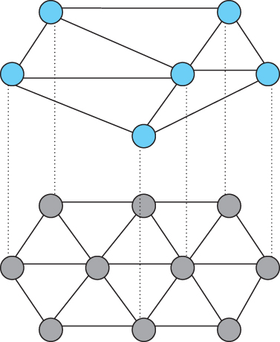
Overlay Network
CDN (Content Distribution Network)
Peer-to-peer
(Routing overlays)
Overlay network layered on top of a physical network
Notes:
The University of Adelaide, School of Computer Science
Chapter 2 — Instructions: Language of the Computer

Slide 65
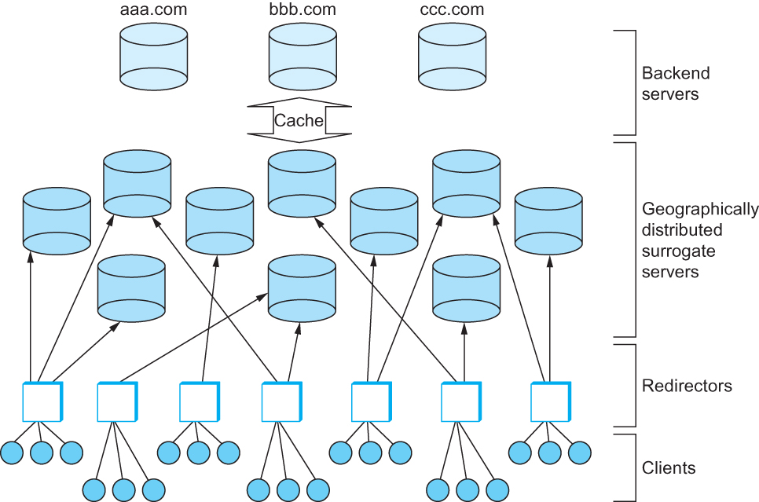
Content Distribution Network (CDN)
Components in a Content Distribution Network (CDN) (eg. Akamai, Limelight, …)
Notes:
The University of Adelaide, School of Computer Science
Chapter 2 — Instructions: Language of the Computer

Slide 66



Single Server, Poor Performance
Single server
  Single point of failure
  Easily overloaded
  Far from most clients
Popular content
  Popular site
  “Flash crowd”
  Denial of Service attack

Slide 67
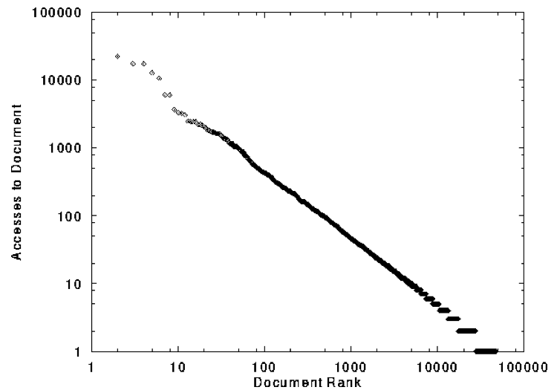
Skewed Popularity of Web Traffic
“Zipf” or “power-law” distribution
Characteristics of WWW Client-based Traces
Carlos R. Cunha, Azer Bestavros, Mark E. Crovella, BU-CS-95-01

Slide 68

Web Proxy Caches
origin
server
Proxy
server
HTTP request
HTTP request
client
HTTP response
HTTP response
HTTP request
HTTP response
client

Slide 69
Forward Proxy
Cache “close” to the client
  Under administrative control
  of client-side AS
Explicit proxy
  Requires configuring browser
Implicit proxy
  Service provider deploys an “on path” proxy
  … that intercepts and handles Web requests
Proxy
server
HTTP request
client
HTTP response
HTTP request
HTTP response
client

Slide 70
Reverse Proxy
Cache “close” to server
  Either by proxy run by server or in third-party content distribution network (CDN)
Directing clients to the proxy
  Map the site name to the
  IP address of the proxy
origin
server
Proxy
server
HTTP request
HTTP response
HTTP request
HTTP response
origin
server

Slide 71

Google Design
. .
.
Servers
Data Centers
Servers
Router
Router
Private Backbone
Reverse Proxy
Reverse Proxy
Internet
Requests
Client
Client
Client

Slide 72
Content Distribution Network
origin server
in North America
Proactive content replication
  Content provider (e.g., CNN) contracts with a CDN
CDN replicates the content
  On many servers spread throughout the Internet
Updating the replicas
  Updates pushed to replicas when the content changes
CDN distribution node
CDN server
in S. America
CDN server
in Asia
CDN server
in Europe

Slide 73
Server Selection Policy
Live server
  For availability
Lowest load
  To balance load across the servers
Closest
  Nearest geographically, or in round-trip time
Best performance
  Throughput, latency, …
Cheapest bandwidth, electricity, …
Requires continuous monitoring of liveness, load, and performance

Slide 74
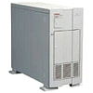

Server Selection Mechanism
Application
  HTTP redirection
Advantages
  Fine-grain control
  Selection based on client IP address
Disadvantages
  Extra round-trips for TCP connection to server
  Overhead on the server
GET
Redirect
GET
OK

Slide 75

Server Selection Mechanism
Advantages
  No extra round trips
  Route to nearby server
Disadvantages
  Does not consider network or server load
  Different packets may go to different servers
  Used only for simple request-response apps
Routing
  Anycast routing
1.2.3.0/24
1.2.3.0/24

Slide 76

Server Selection Mechanism
Advantages
  Avoid TCP set-up delay
  DNS caching reduces overhead
  Relatively fine control
Disadvantage
  Based on IP address of local DNS server
  DNS TTL limits adaptation
Naming
  DNS-based server selection
1.2.3.4
DNS
query
1.2.3.5
local DNS server
Notes:
- “Hidden load” effect

Slide 77
How Akamai Works

Slide 78
Akamai Statistics
Distributed servers
  Servers: ~100,000
  Networks: ~1,000
  Countries: ~70
Many customers
  Apple, BBC, FOX, GM IBM, MTV, NASA, NBC, NFL, NPR, Puma, Red Bull, Rutgers, SAP, …
Client requests
  20+M per second
  Half in the top
  45 networks
  20% of all Web traffic worldwide

Slide 79

How Akamai Uses DNS
cnn.com (content provider)
HTTP
DNS root server
GET index.html
Akamai
cluster
http://cache.cnn.com/foo.jpg
Akamai global
DNS server
1
2
HTTP
Akamai regional
DNS server
Nearby
Akamai
cluster
End user

Slide 80
How Akamai Uses DNS
cnn.com (content provider)
HTTP
DNS TLD server
DNS lookup
cache.cnn.com
Akamai
cluster
Akamai global
DNS server
1
2
3
ALIAS:
g.akamai.net
4
Akamai regional
DNS server
Nearby
Akamai
cluster
End user

Slide 81
How Akamai Uses DNS
cnn.com (content provider)
HTTP
DNS TLD server
DNS lookup
g.akamai.net
Akamai
cluster
Akamai global
DNS server
5
1
2
3
4
6
Akamai regional
DNS server
ALIAS
a73.g.akamai.net
Nearby
Akamai
cluster
End user

Slide 82
How Akamai Uses DNS
cnn.com (content provider)
HTTP
DNS TLD server
Akamai
cluster
Akamai global
DNS server
5
1
2
3
4
6
Akamai regional
DNS server
7
DNS a73.g.akamai.net
8
Address
1.2.3.4
Nearby
Akamai
cluster
End user

Slide 83
How Akamai Uses DNS
cnn.com (content provider)
HTTP
DNS TLD server
Akamai
cluster
Akamai global
DNS server
5
1
2
3
4
6
Akamai regional
DNS server
7
8
9
Nearby
Akamai
cluster
End user
GET /foo.jpg
Host: cache.cnn.com

Slide 84

How Akamai Uses DNS
cnn.com (content provider)
HTTP
DNS TLD server
GET foo.jpg
11
12
Akamai
cluster
Akamai global
DNS server
5
1
2
3
4
6
Akamai regional
DNS server
7
8
9
Nearby
Akamai
cluster
End user
GET /foo.jpg
Host: cache.cnn.com

Slide 85
How Akamai Uses DNS
cnn.com (content provider)
HTTP
DNS TLD server
11
12
Akamai
cluster
Akamai global
DNS server
5
1
2
3
4
6
Akamai regional
DNS server
7
8
9
Nearby
Akamai
cluster
End user
10

Slide 86
How Akamai Works: Cache Hit
cnn.com (content provider)
HTTP
DNS TLD server
Akamai
cluster
Akamai global
DNS server
1
2
Akamai regional
DNS server
3
4
5
Nearby
Akamai
cluster
End user
6

